Slide 2
Box Folder
https://go.igb.illinois.edu/biocluster-workshop

Slide 3
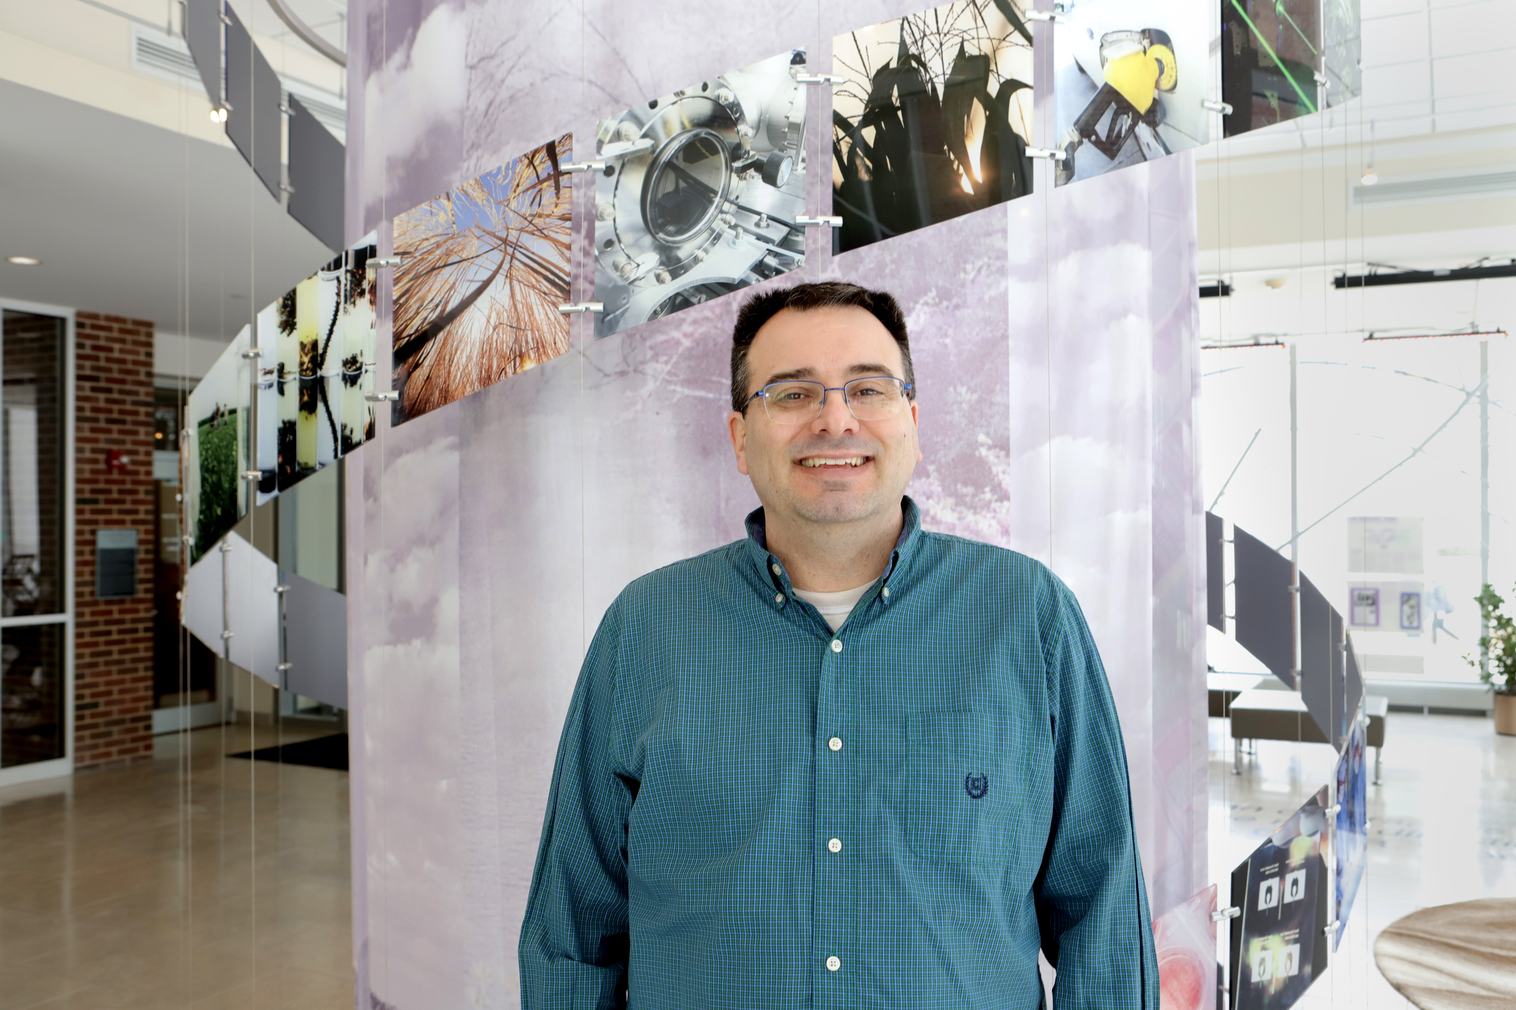


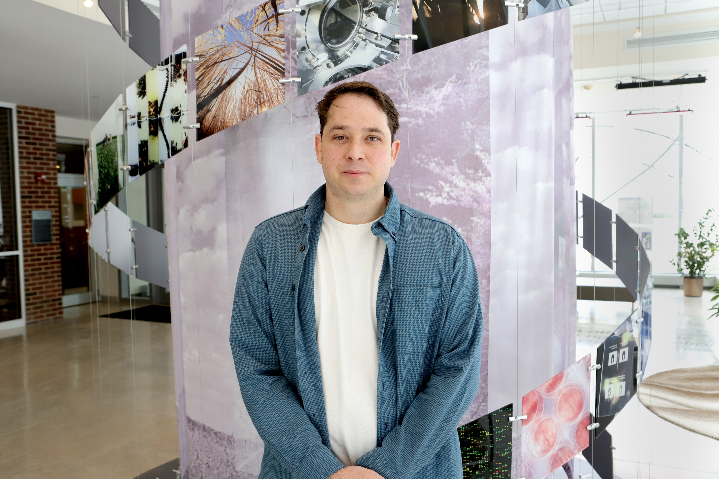
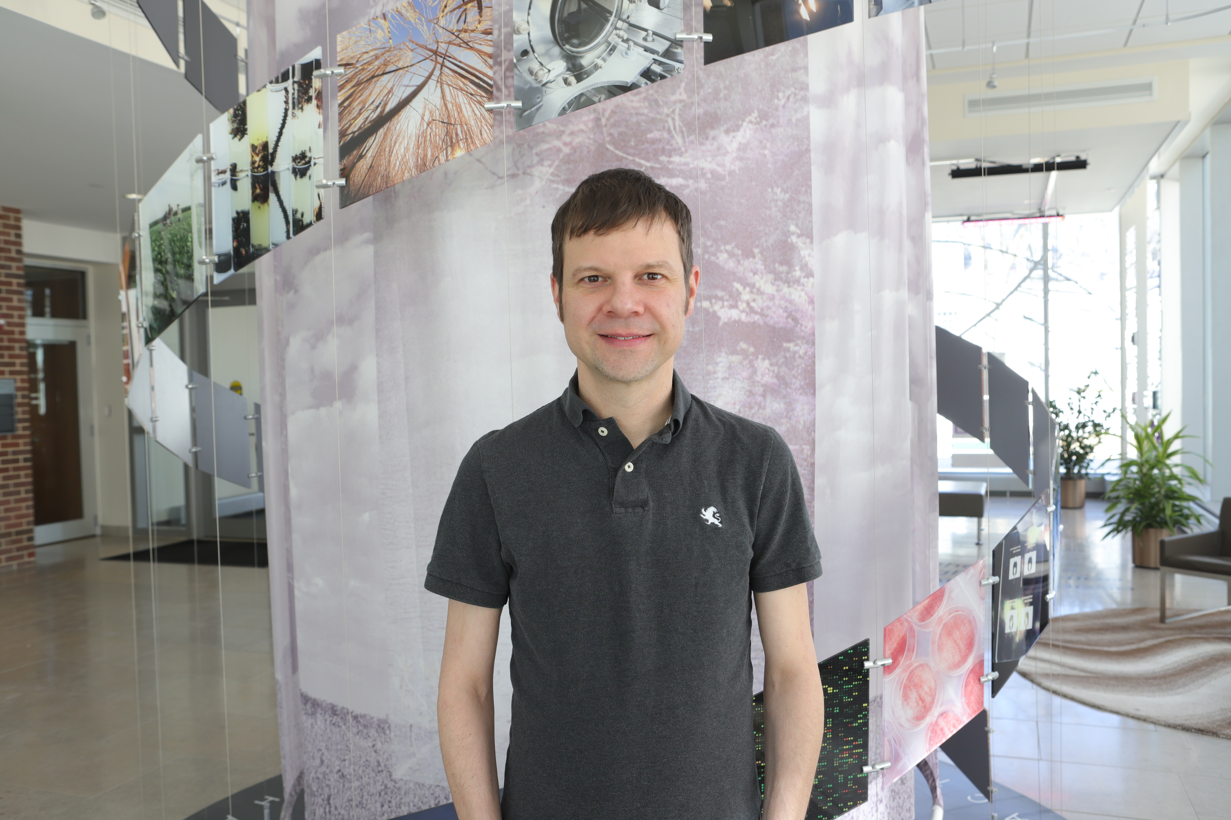
The Biocluster Workshop Team
Daniel Davidson
Angela Dickinson
Yifei Kang
Russell Davidson
David Slater

Slide 4
Why am I here?
My Adviser told me to come!
I want to see where my tax dollars go.
I use AWS/Azure. Why Should I use a local cluster?
I need to analyze a thousand different samples
In 1 day
My laptop from Best Buy is too slow to analyze a metagenome dataset.

Slide 5
What is a Cluster?
Dictionary definition
A group or bunch of something
In computing
A group of loosely coupled computers that work closely together

Slide 6
Why use a Cluster?
To run many serial applications on similar hardware
Tu run a large, parallel application more quickly
To share processing resources across a group of people
To reduce the costs of running applications
To reliably run applications that have a long run time
To share computational data with others quickly
To reduce downtime due to hardware faults

Slide 7
Terminology
Head Node – The system that controls the cluster
Worker (Compute) Node – Systems that perform the computations in a cluster
Login Node – System that users log into to use a cluster
Storage Node – System that contains storage available for the cluster
Scheduler – Software that controls when jobs are run and the node they are run on

Slide 8
Terminology (cont)
Queue/Partition – A structure to which worker nodes and jobs are assigned
Processor/Core/Thread – All mean a CPU, different programs will use these interchangeable.
Serial – A job that runs within one node on one processor
Multithreaded – A job that with one node on more than one processor
Parallel – A job that can be run across several nodes
Shell – A program that users employ to type commands

Slide 9
Terminology (cont)
Script – A file that contains a series of commands that are executed
Job – A chunk of work that has been submitted to the cluster
Path – Where something is in the directory structure

Slide 10
How Does a Cluster Work?
Think of a cluster as a building contractor
The site manager (the job scheduler SLURM) determines what work need to be done and in what order. He works in an office (the head node)
The foremen (worker nodes) manage a team of workers (processors). The foremen manage the teams with differing specialties (queues/partitions)
When you want something done, you can drop off blueprints (a job script) with the site manager.
You can also say you want to talk to a worker directly, then the site manager will assign worker(s) from a foreman’s team.

Slide 11
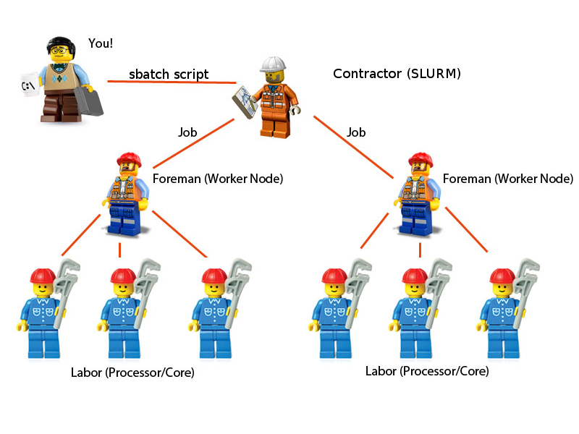
How Does a Cluster Work?

Slide 12
History of HPC at the IGB
Hive (2006)
48 cores, 192GB of RAM
Classroom (2008)
192 cores, 384GB of RAM
EBI (2008)
200 cores, 400GB of RAM
Computation (2009)
80 cores, 240GB of RAM

Slide 13
History of HPC at the IGB (cont)
Biocluster (2011)
Initially composed of existing HPC resources
Default queue updated in 2013
Single copy GPFS system
10 GbE networking
Biocluster V2 (2018)
Initially composed of HPC resources from Biocluster
Double copy GPFS system
Normal and Low Memory queues updated 2019
40 GbE networking
456 Cores, 6.4TB Memory, 800TB Storage

Slide 14
History of HPC at the IGB (cont)
Biocluster V3 (Current)
5 New Default Nodes – 128 AMD CPUs, 2TB RAM
3 GPU Nodes with 2x A40 GPUs
2.4 Petabytes Double Copy GPFS Filesystem (1.2PB usable space)
GPFS Snapshots enabled. Allows you to retrieve deleted data

Slide 15
What Partition do I use?
Normal (default)
All Jobs requiring CPUs only
GPU
Jobs that require access to GPUs
Lab Specific Queues
Some labs buy their own compute nodes

Slide 16
Other Biocluster Services
Normal (default) ($1.16/core/day)
5 Nodes with 128 AMD CPUs
2TB RAM
10Gb Ethernet
GPU ($2.13/GPU/day)
3 Nodes with 32 AMD CPUs
256GB RAM
2x Nvidia A40 GPUS – 48GB RAM
10Gb Ethernet
Storage ($8.78/TB/month)
Replicated data across 10 storage nodes

Slide 17
Advanced Biocluster Services
Biodatabase (free)
High performance MySQL server
Jupyter Notebooks
Runs R and Python in a web browser
Singularity Containers
Loads Docker and Singularity containers
Mirrors (free)
Local datasets, let us know if you want to add one
Bioarchive ($200/TB/10 yr)
Long term data storage for completed projects
Saves data to tape

Slide 18
Why so Many Fee Based Services?
Hive Cluster Experience
Important vs Unimportant
Further Evidence from Pittsburg Supercomputing Center (PSC)
Long queues
Overused resources
Storage Issues
WORSE Data
Large Datasets
Sustainability
Ensure funding for new resources

Slide 19
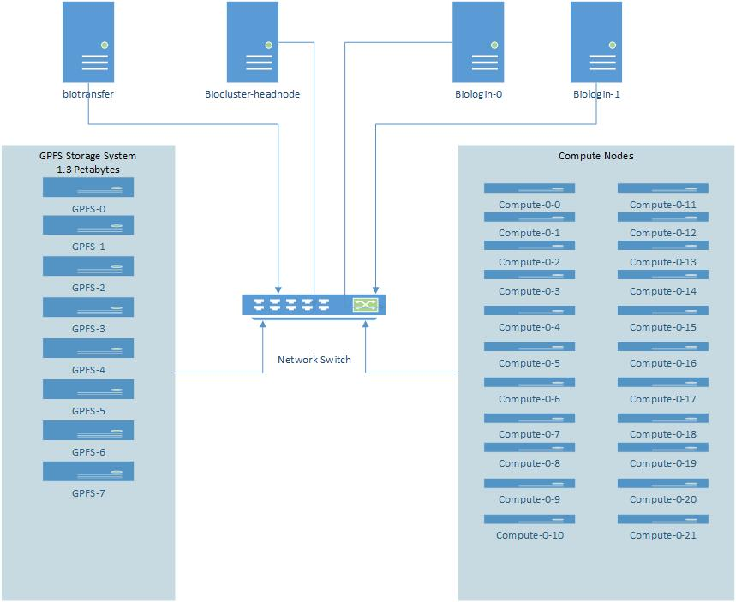
Biocluster Layout

Slide 20
Login to the Biocluster
Open MobaXterm on PC (Terminal on Mac)
Click on “Start Local Terminal”
Type “ssh username@biologin.igb.illinois.edu”
Enter your password
Answer “No” when asked to save your password
If successful, your prompt should look something like: [username@biologin-2 ~]

Slide 21
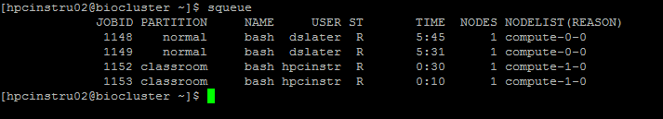
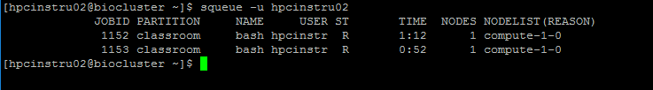
Important Commands: squeue
Shows the status of jobs running in the queues
You can also show the status of just your jobs
CD is complete, R is running, PD is waiting to run

Slide 22
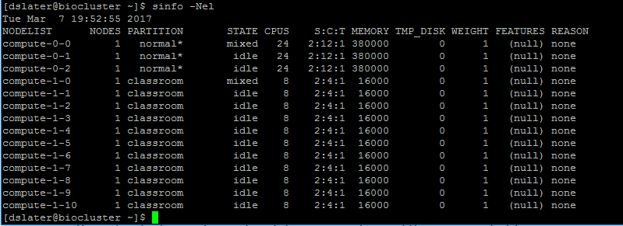
Important Commands: sinfo
Show the properties of queues and nodes

Slide 23
Important Commands: scontrol
Get more details about a job
[biologin-2]$ scontrol show job 1148
UserId=dslater(683) GroupId=dslater(683)
Priority=4294901672 Nice=0 Account=(null) QOS=normal
JobState=RUNNING Reason=None Dependency=(null)
Requeue=1 Restarts=0 BatchFlag=0 Reboot=0 ExitCode=0:0
RunTime=00:25:35 TimeLimit=UNLIMITED TimeMin=N/A
SubmitTime=2017-03-07T19:33:20 EligibleTime=2017-03-07T19:33:20
StartTime=2017-03-07T19:33:20 EndTime=Unknown
PreemptTime=None SuspendTime=None SecsPreSuspend=0
Partition=normal AllocNode:Sid=biocluster:117639
ReqNodeList=(null) ExcNodeList=(null)
NodeList=compute-0-0
BatchHost=compute-0-0
NumNodes=1 NumCPUs=1 CPUs/Task=1 ReqB:S:C:T=0:0:*:*
TRES=cpu=1,mem=15800,node=1
Socks/Node=* NtasksPerN:B:S:C=0:0:*:* CoreSpec=*
MinCPUsNode=1 MinMemoryCPU=15800M MinTmpDiskNode=0
Features=(null) Gres=(null) Reservation=(null)
Shared=OK Contiguous=0 Licenses=(null) Network=(null)
Command=/bin/bash
WorkDir=/home/a-m/dslater
Power= SICP=0

Slide 24
Important Commands: module
Loads the necessary environment for a program
module avail
Shows all modules/software installed
module load
Load the environment for a program
module list
Shows modules loaded
module unload
Removes a loaded module
module purge
Removes all loaded modules

Slide 25
Pay attention to module messages
module load STAR/2.7.6a-IGB-gcc-8.2.0
module purge
module load picard/2.10.1-Java-1.8.0_152
module purge
module load CheckM/1.1.3-IGB-gcc-8.2.0-Python-3.7.2

Slide 26
Transferring Files
SFTP
Cyberduck (OSX, Windows) https://cyberduck.io
WinSCP (Windows) https://winscp.net/eng/index.php
FileZilla (OSX, Windows, Linux) https://filezilla-project.org
Globus Online
Transfers large files (TBs) reliably and easily
Transfer between clusters around the world
http://help.igb.illinois.edu/Globus

Slide 27
Resources
Biocluster home page
http://biocluster.igb.illinois.edu
Biocluster accounting
http://bioapps3.igb.illinois.edu/accounting/
SLURM script generator
http://www-app.igb.illinois.edu/tools/slurm/
SLURM tutorials
https://slurm.schedmd.com/tutorials.html
SLURM quick reference
https://slurm.schedmd.com/pdfs/summary.pdf

Slide 28
Policies and Questions
Detailed policies and directions
http://help.igb.illinois.edu/Biocluster
Do not install software yourself
email help@igb.illinois.edu
When we install software, then everyone can use it
Exceptions are most R (CRAN/Bioconductor) Packages and Python (Pypi) Packages
Program running slow? E-mail us!
Don’t know what resources to use? E-mail us!
Any other questions? Email us!

Slide 29
Interactive Jobs
When you need to provide unpredictable input
[hpcinstru02@biologin-2 ~]$ hostname
biologin-0.igb.illinois.edu
[hpcinstru02@biologin-2 ~]$ srun -p classroom --pty bash
[hpcinstru02@compute-7-0 ~]$ hostname
compute-7-0
[hpcinstru02@compute-7-0 ~]$ exit
exit
[hpcinstru02@biologin-2 ~]$ hostname
biologin-0.igb.illinois.edu
[hpcinstru02@biologin-2 ~]$

Slide 30
Bash Scripts
Bash scripts are a series of commands that can be grouped together within files to accomplish a series of tasks.
This allows you to run one command instead of several successive commands.

Slide 31
Example Bash Script
Start an interactive job to the classroom queue
This program waits 15 seconds and then prints out “Hello World” in the terminal
Make this file, give it execute permissions, and run
#!/bin/bash
#This program sleeps for 15 seconds and prints
#"Hello World" to the command line
sleep 15
echo "Hello World"

Slide 32
FastQC
FastQC is a quality control application for high throughput sequence data
Checks the quality of their sequence data
Generates an HTML report
http://www.bioinformatics.babraham.ac.uk/projects/fastqc/

Slide 33
Prepare to Run Jobs
Copy example data to your home directory
$ mkdir unix_exercise_hpc
$ cd unix_exercise_hpc/
$ cp -r /home/classroom/hpcbio/unix_exercise_hpc/data/raw-seq ./
$ cp -r /home/classroom/hpcbio/unix_exercise_hpc/data/raw-seq-ordered ./
$ cp -r /home/classroom/hpcbio/unix_exercise_hpc/data/blast ./
$ mkdir -p results/fastqc-rawseq
$ mkdir results/blast
$ mkdir results/fastqc-rawseq-ordered
$ mkdir results/fastqc-rawseq-unordered

Slide 34
Important Commands: sbatch
Submit a job to the cluster
-p partition you want to summit to
Default is “normal”
-N Number of nodes
Default is 1
-n Number of CPUs/Cores per node
Default is 1
--mem Amount of Memory to reserve
Default 15G

Slide 35
Important Commands: sbatch
Submit a job to the cluster
--mail-user Your email address
Email address to receive job messages
--mail-type Types of Email to Receive
ALL, BEGIN, END, FAIL
-D Working Directory
Should always specify. Start location of your job.
Where slurm.out files will go
--gres Reserve GPUs
Many more options
https://slurm.schedmd.com/sbatch

Slide 36
Exercise 1 - Create the FastQC Job Script
Use nano text editor to create a file name samplefastqc.sh
#!/bin/bash
#SBATCH -N 1
#SBATCH –n 1
#SBATCH -p classroom
#SBATCH --mail-user=EMAIL@ADDRESS
#SBATCH --mail-type=ALL
#SBATCH -D /home/a-m/USERNAME/unix_exercise_hpc
module load FastQC/0.11.8-Java-1.8.0_152
echo “Start FastQC Job”
sleep 20
fastqc -o results/fastqc-rawseq raw-seq/yeast_1_50K.fastq
echo “Finish FastQC Job”

Slide 37
Exercise 1 - Run the FastQC Job Script
Submit the job
[hpcinstru02@biologin-2 unix_exercise]$ sbatch samplefastqc.sh
Submitted batch job 1163
Check the status of the job
[hpcinstru02@biologin-2 unix_exercise]$ squeue
JOBID PARTITION NAME USER ST TIME NODES NODELIST(REASON)
1164 classroom fastqc.s hpcinstr R 0:02 1 compute-1-0

Slide 38
Exercise 1 - Check Output File for Errors
[hpcinstru02@biologin-2 unix_exercise_hpc]$ cat slurm-1165.out
Started analysis of yeast_1_50K.fastq
Approx 5% complete for yeast_1_50K.fastq
Approx 10% complete for yeast_1_50K.fastq
Approx 15% complete for yeast_1_50K.fastq
Approx 20% complete for yeast_1_50K.fastq
Approx 25% complete for yeast_1_50K.fastq
Approx 30% complete for yeast_1_50K.fastq
Approx 35% complete for yeast_1_50K.fastq
Approx 40% complete for yeast_1_50K.fastq
Approx 45% complete for yeast_1_50K.fastq
Approx 50% complete for yeast_1_50K.fastq
Approx 55% complete for yeast_1_50K.fastq
Approx 60% complete for yeast_1_50K.fastq
Approx 65% complete for yeast_1_50K.fastq
Approx 70% complete for yeast_1_50K.fastq
Approx 75% complete for yeast_1_50K.fastq
Approx 80% complete for yeast_1_50K.fastq
Approx 85% complete for yeast_1_50K.fastq
Approx 90% complete for yeast_1_50K.fastq
Approx 95% complete for yeast_1_50K.fastq
Approx 100% complete for yeast_1_50K.fastq
Analysis complete for yeast_1_50K.fastq

Slide 39
Important Things to Note
Job length
If over 24 hours, can this be split up, can threads be increased?
Many small files
Greater than 1000 per folder
To be avoided! This causes terrible performance and significantly increases storage costs
Group into larger files
Data
Save money by removing temp files
Archive data as soon as reasonable
Let us know if you are adding several TB of data
Use /scratch whenever possible for temporary files

Slide 40
Important Things to Note
Make sure you are not on the login node when you launch an application
You can check the system you are on by typing “hostname”
Make sure you reserve as many processors as you specify in the program
A mismatch here can increase your runtime or costs
Make sure you reserve as much RAM as needed
Overestimating increases cost, underestimating crashes
Know which resources work the best
Sometimes using a gpu or lowmem system is better

Slide 41
Data
Group Folder
Created by CNRG for you in /home/labs or /home/groups
Need a CFOP, University Account Number, to charge
Sharing data with another user
Send files with /home/a-m/dropboxes/USERNAME
Or /home/n-z/dropboxes/USERNAME
Receive files at /home/a-m/USERNAME/dropbox
Or /home/n-z/USERNAME/dropbox
No HIPAA Data is allowed on the biocluster

Slide 42
SLURM Environment Variables
$SLURM_JOB_ID – The job number
Assigned automatically by SLURM
$SLURM_JOB_NAME – The name of the job
Similar to the script name
Or you can specify one with -J
$SLURM_NTASKS – Number of reserved Processors
Assigned automatically by SLURM
Value is the multiple of the -n and -N values

Slide 43
Multi-Processor Jobs
The program must support it!
Our default nodes have 128 processor. Most programs loose efficiency after 8 or 16 processors.
Money adds up if not properly submitted
How to run a program
program --help
man program
module whatis program
Use $SLURM_NTASKS

Slide 44
Exercise 2 - Create the BLAST Job Script
Use SLURM Script Generator
https://www-app.igb.illinois.edu/tools/slurm/

Slide 45
Exercise 2 - Create the BLAST Job Script
Use nano text editor to create blast.sh
#!/bin/bash
#SBATCH -N 1
#SBATCH –n 2
#SBATCH -p classroom
#SBATCH --mail-user=EMAIL@ADDRESS
#SBATCH --mail-type=ALL
#SBATCH -D /home/a-m/USERNAME/unix_exercise_hpc
module load BLAST+/2.16.0-IGB-gcc-8.2.0
module load ncbi-blastdb/20250211
echo “Start BLAST Job”
blastp -db swissprot \
-query blast/query.txt \
-num_threads ${SLURM_NTASKS} > results/blast/results.txt
echo “Finish BLAST Job”

Slide 46
Exercise 2 - Run the BLAST Job Script
Submit the job
[hpcinstru02@biologin-2 unix_exercise_hpc]$ sbatch blast.sh
Submitted batch job 1164
Check the status of the job
[hpcinstru02@biologin-2 unix_exercise_hpc]$ squeue
JOBID PARTITION NAME USER ST TIME NODES NODELIST(REASON)
1164 classroom blast.s hpcinstr R 0:02 1 compute-1-0

Slide 47
Check Job Stats
sacct can get stats for a job after its completed
https://slurm.schedmd.com/sacct.html
sacct -j 6694365 -format=JobID,State,Elapsed,NCPUS,MaxRSS
seff can get stats for a job after its completed
seff 6694365
Biocluster Accounting
Shows current and previous jobs
https://bioapps3.igb.illinois.edu/accounting

Slide 48
GPU Jobs – Example
Use gpu partition
Reserve gpus with --gres parameter
Maximum of 2 GPUs
#!/bin/bash #SBATCH -N 1 #SBATCH –n 1 #SBATCH -p gpu
#SBATCH --gres=gpu:1 #SBATCH –mail-user=dslater@illinois.edu #SBATCH --mail-type=ALL #SBATCH -D /home/a-m/dslater
module load Tensorflow-GPU/2.3.1-IGB-gcc-8.2.0-Python-3.7.2

Slide 49
Job Arrays
A way to run the same commands on many (hundreds, thousands) of datasets/samples.
A variable called $SLURM_ARRAY_TASK_ID is used to determine the element of the array being run.
#SBATCH –array=1-1000
Limit number of jobs at once with %
#SBATCH –arrray=1-1000%20
$SLURM_ARRAY_TASK_ID becomes 1 in first job, 2 in second job, 3 in the third job, etc…

Slide 50
Bash Variables
cd raw-seq
i=1
ls -l yeast_${i}_50K.fastq
i=2
ls -l yeast_${i}_50K.fastq

Slide 51
Without Job Arrays - Numbered Files
#!/bin/bash #SBATCH -N 1 #SBATCH –n 1 #SBATCH -p classroom #SBATCH --mail-user=EMAIL@ADDRESS #SBATCH --mail-type=ALL #SBATCH -D /home/a-m/USERNAME/unix_exercise_hpc
module load FastQC/0.11.8-Java-1.8.0_152 echo "Starting FastQC job“
fastqc -o results/fastqc-rawseq-ordered raw-seq-ordered/yeast_1_50K.fastq
fastqc -o results/fastqc-rawseq-ordered raw-seq-ordered/yeast_2_50K.fastq
fastqc -o results/fastqc-rawseq-ordered raw-seq-ordered/yeast_3_50K.fastq
fastqc -o results/fastqc-rawseq-ordered raw-seq-ordered/yeast_4_50K.fastq
fastqc -o results/fastqc-rawseq-ordered raw-seq-ordered/yeast_5_50K.fastq
fastqc -o results/fastqc-rawseq-ordered raw-seq-ordered/yeast_6_50K.fastq
echo "Finish FastQC job"

Slide 52
Exercise 3 - Job Arrays - Numbered Files
Here is an example SLURM script for a numbered job array. Save as numbered_job_array.sh
#!/bin/bash #SBATCH -N 1 #SBATCH –n 1 #SBATCH -p classroom #SBATCH --mail-user=EMAIL@ADDRESS #SBATCH --mail-type=ALL #SBATCH --array=1-6 #SBATCH -D /home/a-m/USERNAME/unix_exercise_hpc
module load FastQC/0.11.8-Java-1.8.0_152 echo "Starting FastQC job“
sleep 20
fastqc -o results/fastqc-rawseq-ordered \
raw-seq-ordered/yeast_${SLURM_ARRAY_TASK_ID}_50K.fastq
echo "Finish FastQC job"

Slide 53
Exercise 3 - Run Job Array Numbered Files
Submit the job
[hpcinstru02@biologin-2 unix_exercise_hpc]$ sbatch numbered_job_array.sh
Submitted batch job 1164
Check the status of the job
[hpcinstru02@biologin-2 unix_exercise_hpc]$ squeue
JOBID PARTITION NAME USER ST TIME NODES NODELIST(REASON)
1164 classroom numbered hpcinstr R 0:02 1 compute-1-0

Slide 54
Exercise 3 - View Job Array
#squeue -u USERNAME
[hpcinstru02@biologin-2 unix_exercise_hpc]$ squeue -u hpcinstru02
JOBID PARTITION NAME USER ST TIME NODES NODELIST(REASON)
1152 classroom bash hpcinstr R 2:17:32 1 compute-1-0
1153 classroom bash hpcinstr R 2:17:12 1 compute-1-0
1207_1 classroom numbered hpcinstr R 0:02 1 compute-1-0
1207_2 classroom numbered hpcinstr R 0:02 1 compute-1-0
1207_3 classroom numbered hpcinstr R 0:02 1 compute-1-0
1207_4 classroom numbered hpcinstr R 0:02 1 compute-1-0
1207_5 classroom numbered hpcinstr R 0:02 1 compute-1-0
1207_6 classroom numbered hpcinstr R 0:02 1 compute-1-1

Slide 55
Exercise 4 - Job Arrays - Unnumbered Files
Start by creating a list of all of the unnumbered filenames
$ ls raw-seq/ > unnumbered_filenames.txt

Slide 56
Exercise 4 - Job Arrays – Unnumbered Files
Here is an example slurm array script for fastqc jobs that have unnumbered filenames. Save as unnumbered_job_array.sh.
#!/bin/bash #SBATCH -N 1 #SBATCH –n 1 #SBATCH -p classroom #SBATCH --mail-user=EMAIL@ADDRESS #SBATCH --mail-type=ALL #SBATCH --array=1-9 #SBATCH -D /home/a-m/USERNAME/unix_exercise_hpc
module load FastQC/0.11.8-Java-1.8.0_152
echo "Starting FastQC job“
sleep 20
line=$(sed -n -e "${SLURM_ARRAY_TASK_ID} p" unnumbered_filenames.txt)
fastqc -o results/fastqc-rawseq-unordered raw-seq/${line}
echo "Finish FastQC job"

Slide 57
Exercise 4 - Run Job Arrays – Unnumbered Files
Submit the job
[hpcinstru02@biologin-2 unix_exercise_hpc]$ sbatch unnumbered_job_array.sh
Submitted batch job 1164
Check the status of the job
[hpcinstru02@biologin-2 unix_exercise_hpc]$ squeue
JOBID PARTITION NAME USER ST TIME NODES NODELIST(REASON)
1164 classroom unnumbered hpcinstr R 0:02 1 compute-1-0

Slide 58
Job Dependencies
Instructions on how jobs relate to other jobs
Useful for if you want to run a series of jobs that depend on the output from other jobs
Examples:
-d depend=afterok:jobid Starts after jobid has finished without errors.
-d depend=afterok:jobid,before:jobid2 Starts after jobid is finished, but not until jobid2 has started.
-d depend:afterok:jobid -d depend:afterok:jobid2 Starts after both jobid and jobid2 have finished.
-d depend=afterokarray:jobid Starts after the job array jobid has finished without errors.

Slide 59
Job Dependencies
Why would you do this:
Mostly for job pipelines, a series of programs that depend on each other’s output that are all submitted at once.
Example:
Step 1:
[biologin-2]$ sbatch preprocessing-step.sh Submitted batch job 18866
Step 2:
[biologin-2]$ sbatch -d after:18866 job-array-step.sh Submitted batch job 18870
Step 3:
[biologin-2]$ sbatch –d afterok:18870 postprocessing-step.sh Submitted batch job 18867

Slide 60
What is Wrong I
#!/bin/bash
# ----------------SLURM Parameters----------------
#SBATCH -p normal
#SBATCH -n 1
#SBATCH --mem=15g
#SBATCH -N 1
#SBATCH –D /home/a-m/dslater
# ----------------Load Modules--------------------
# ----------------Commands------------------------
python /home/a-m/dslater/example_script.py

Slide 61
What is Wrong II
#!/bin/bash
# ----------------SLURM Parameters----------------
#SBATCH -p normal
#SBATCH -n 24
#SBATCH --mem=10g
#SBATCH -N 1
# ----------------Load Modules--------------------
module load BLAST+/2.13.0-IGB-gcc-8.2.0
# ----------------Commands------------------------
blastn -query fasta.file -db database_name -outfmt 6 \
-num_alignments 1 -num_descriptions 1 -out output_file

Slide 62
What is Wrong III
#!/bin/bash
# ----------------SLURM Parameters----------------
#SBATCH -p gpu
#SBATCH -n 1
#SBATCH --mem=100g
#SBATCH -N 1
#SBATCH -D /home/a-m/dslater
# ----------------Load Modules--------------------
module load Tensorflow-GPU/2.3.1-IGB-gcc-8.2.0-Python-3.7.2
# ----------------Commands------------------------
python /home/a-m/dslater/tensor_models.py

Slide 63
What is Wrong IV
# ----------------SLURM Parameters----------------
#SBATCH --partition normal
#SBATCH --ntasks 1
#SBATCH --mem=15g
#SBATCH --nodes 1
#SBATCH --chdir /home/a-m/dslater
# ----------------Load Modules--------------------
module load SAMtools/1.11-IGB-gcc-8.2.0
# ----------------Commands------------------------
samtools stats /home/a-m/dslater/example.bam

Slide 64
Thanks
Daniel Davidson
Angela Dickinson
Yifei Kang
Russell Davidson

