Slide 5



Center For Advanced Bioenergy and Bioproducts Innovation
Department of Energy in partnership with 16 universities and national labs
Genomics and Eco-evolution of Multi-scale Symbioses
Interdisciplinary Institute researching pollinator interaction model to understand impact and dynamics of nested microbes.
HPCBio
High Performance Biological Computing
Carver Biotechnology Center
MSI
Microbial Systems Initiative
Campus-wide effort in partnership with 8 departments
Molecule Maker Lab Institute
Interdisciplinary initiative with leaders in AI and organic synthesis with Penn State and Rochester Institute of Technology
Personalized Nutrition Initiative
Partnership between IGB and the College of Agricultural, Consumer and Environmental Sciences (ACES)
PNI
Zeiss Labs@location Partnership
Zeiss Microscopy

Slide 6
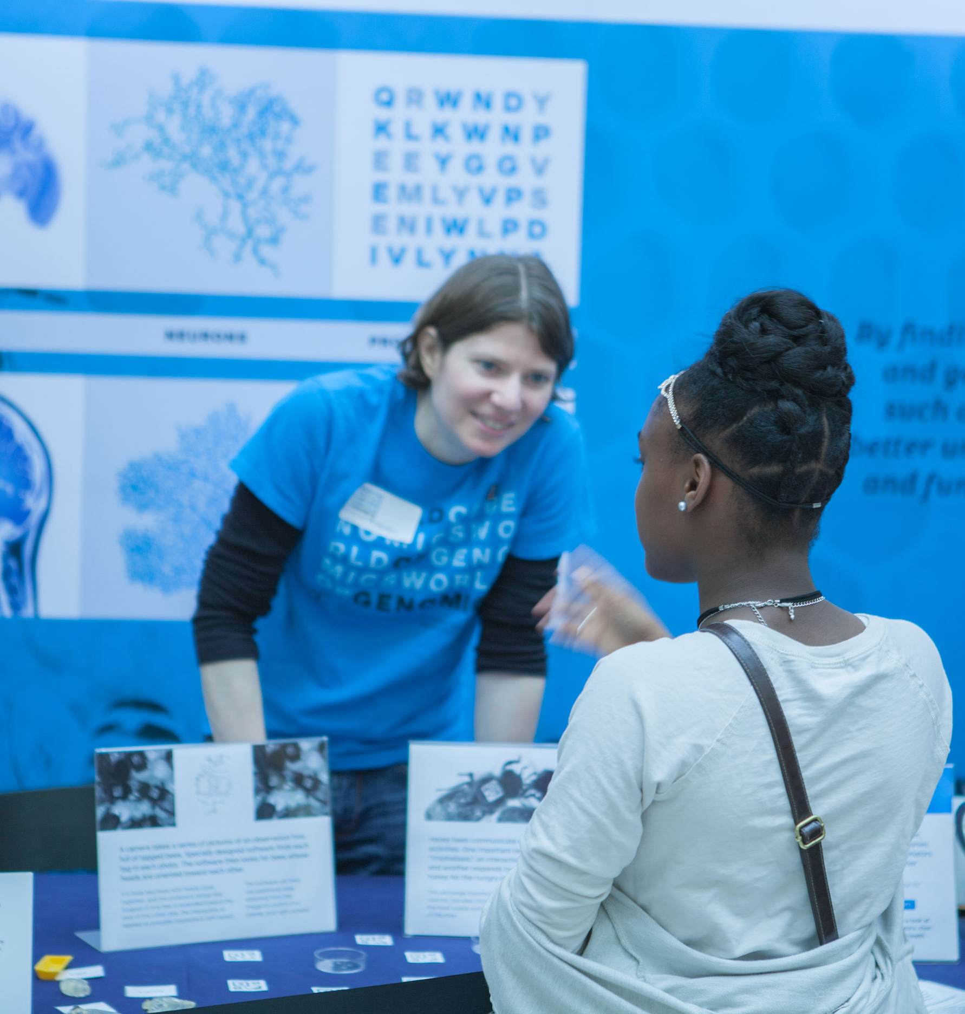
Outreach and
Public Engagement
Fulfill Land Grant mission
Help faculty get big grants
Make new friends—help seed philanthropic efforts
Contribute to trainee professional development

Slide 7
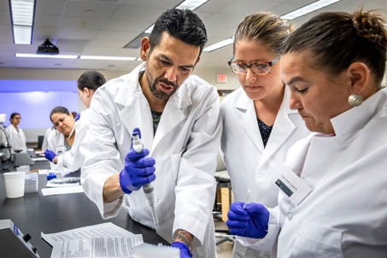
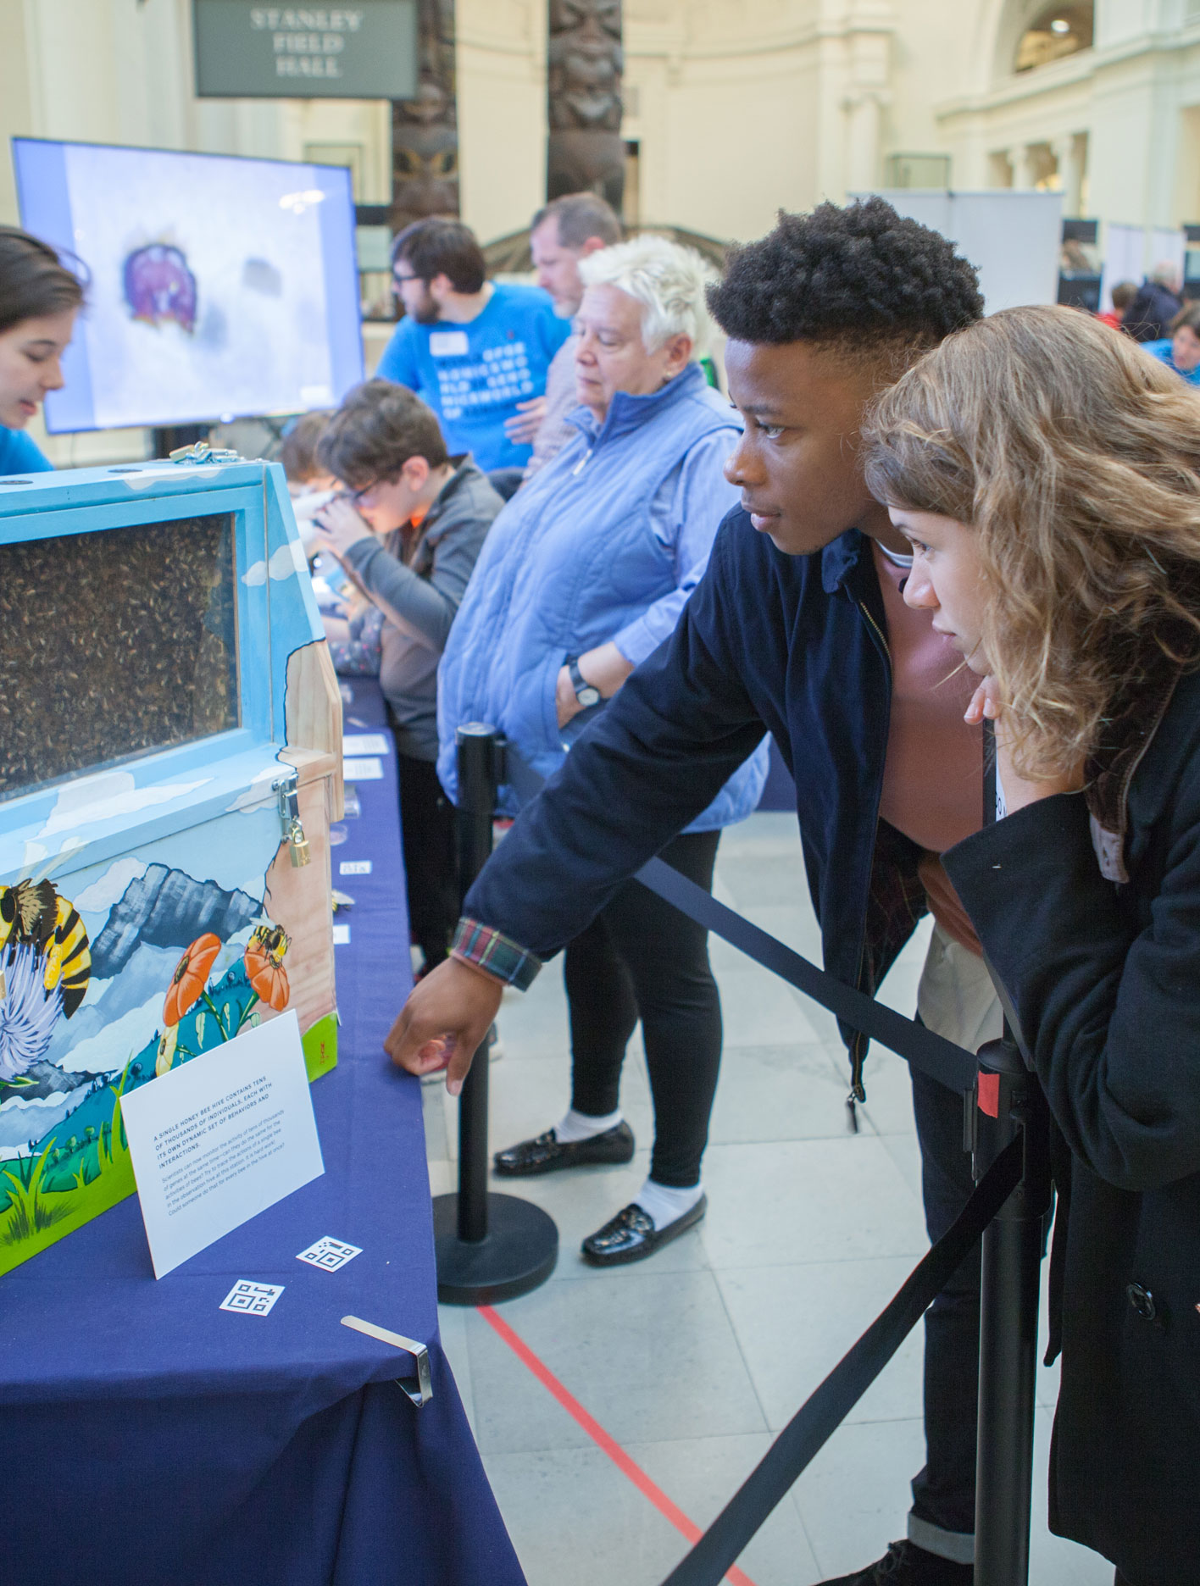
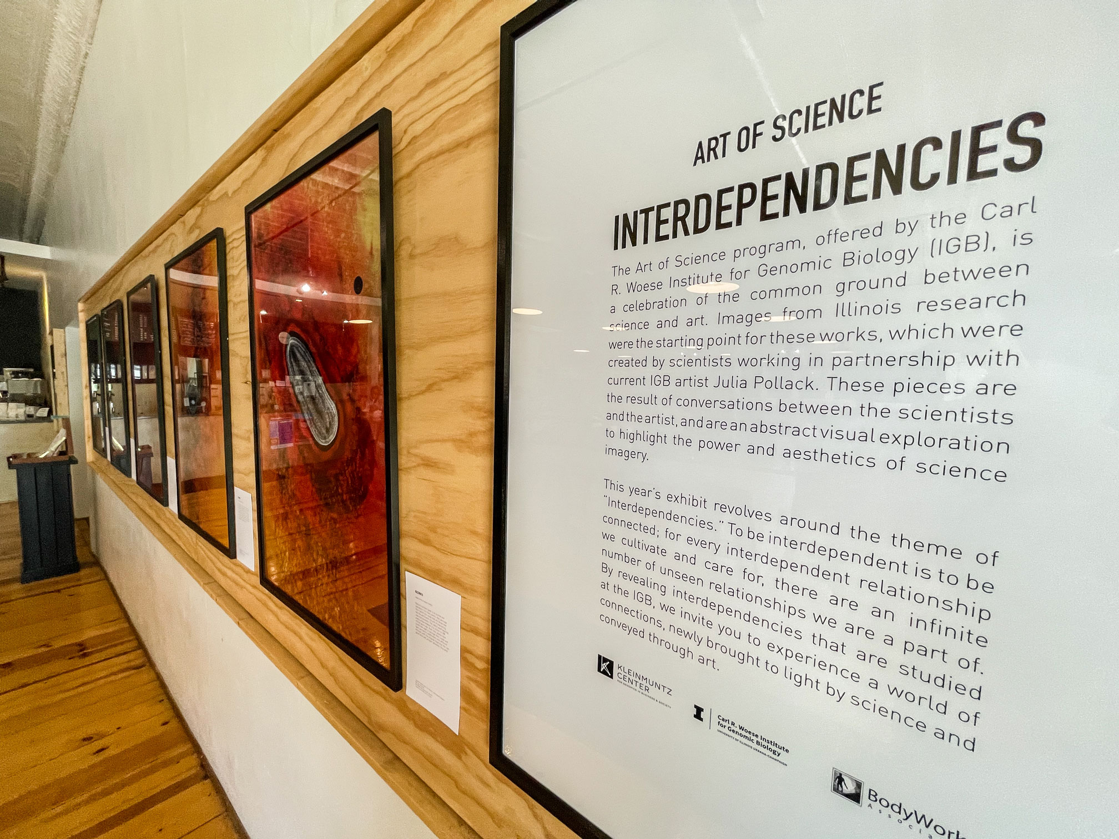

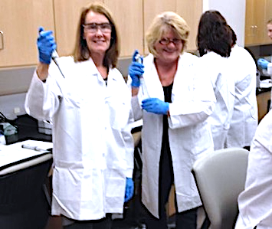
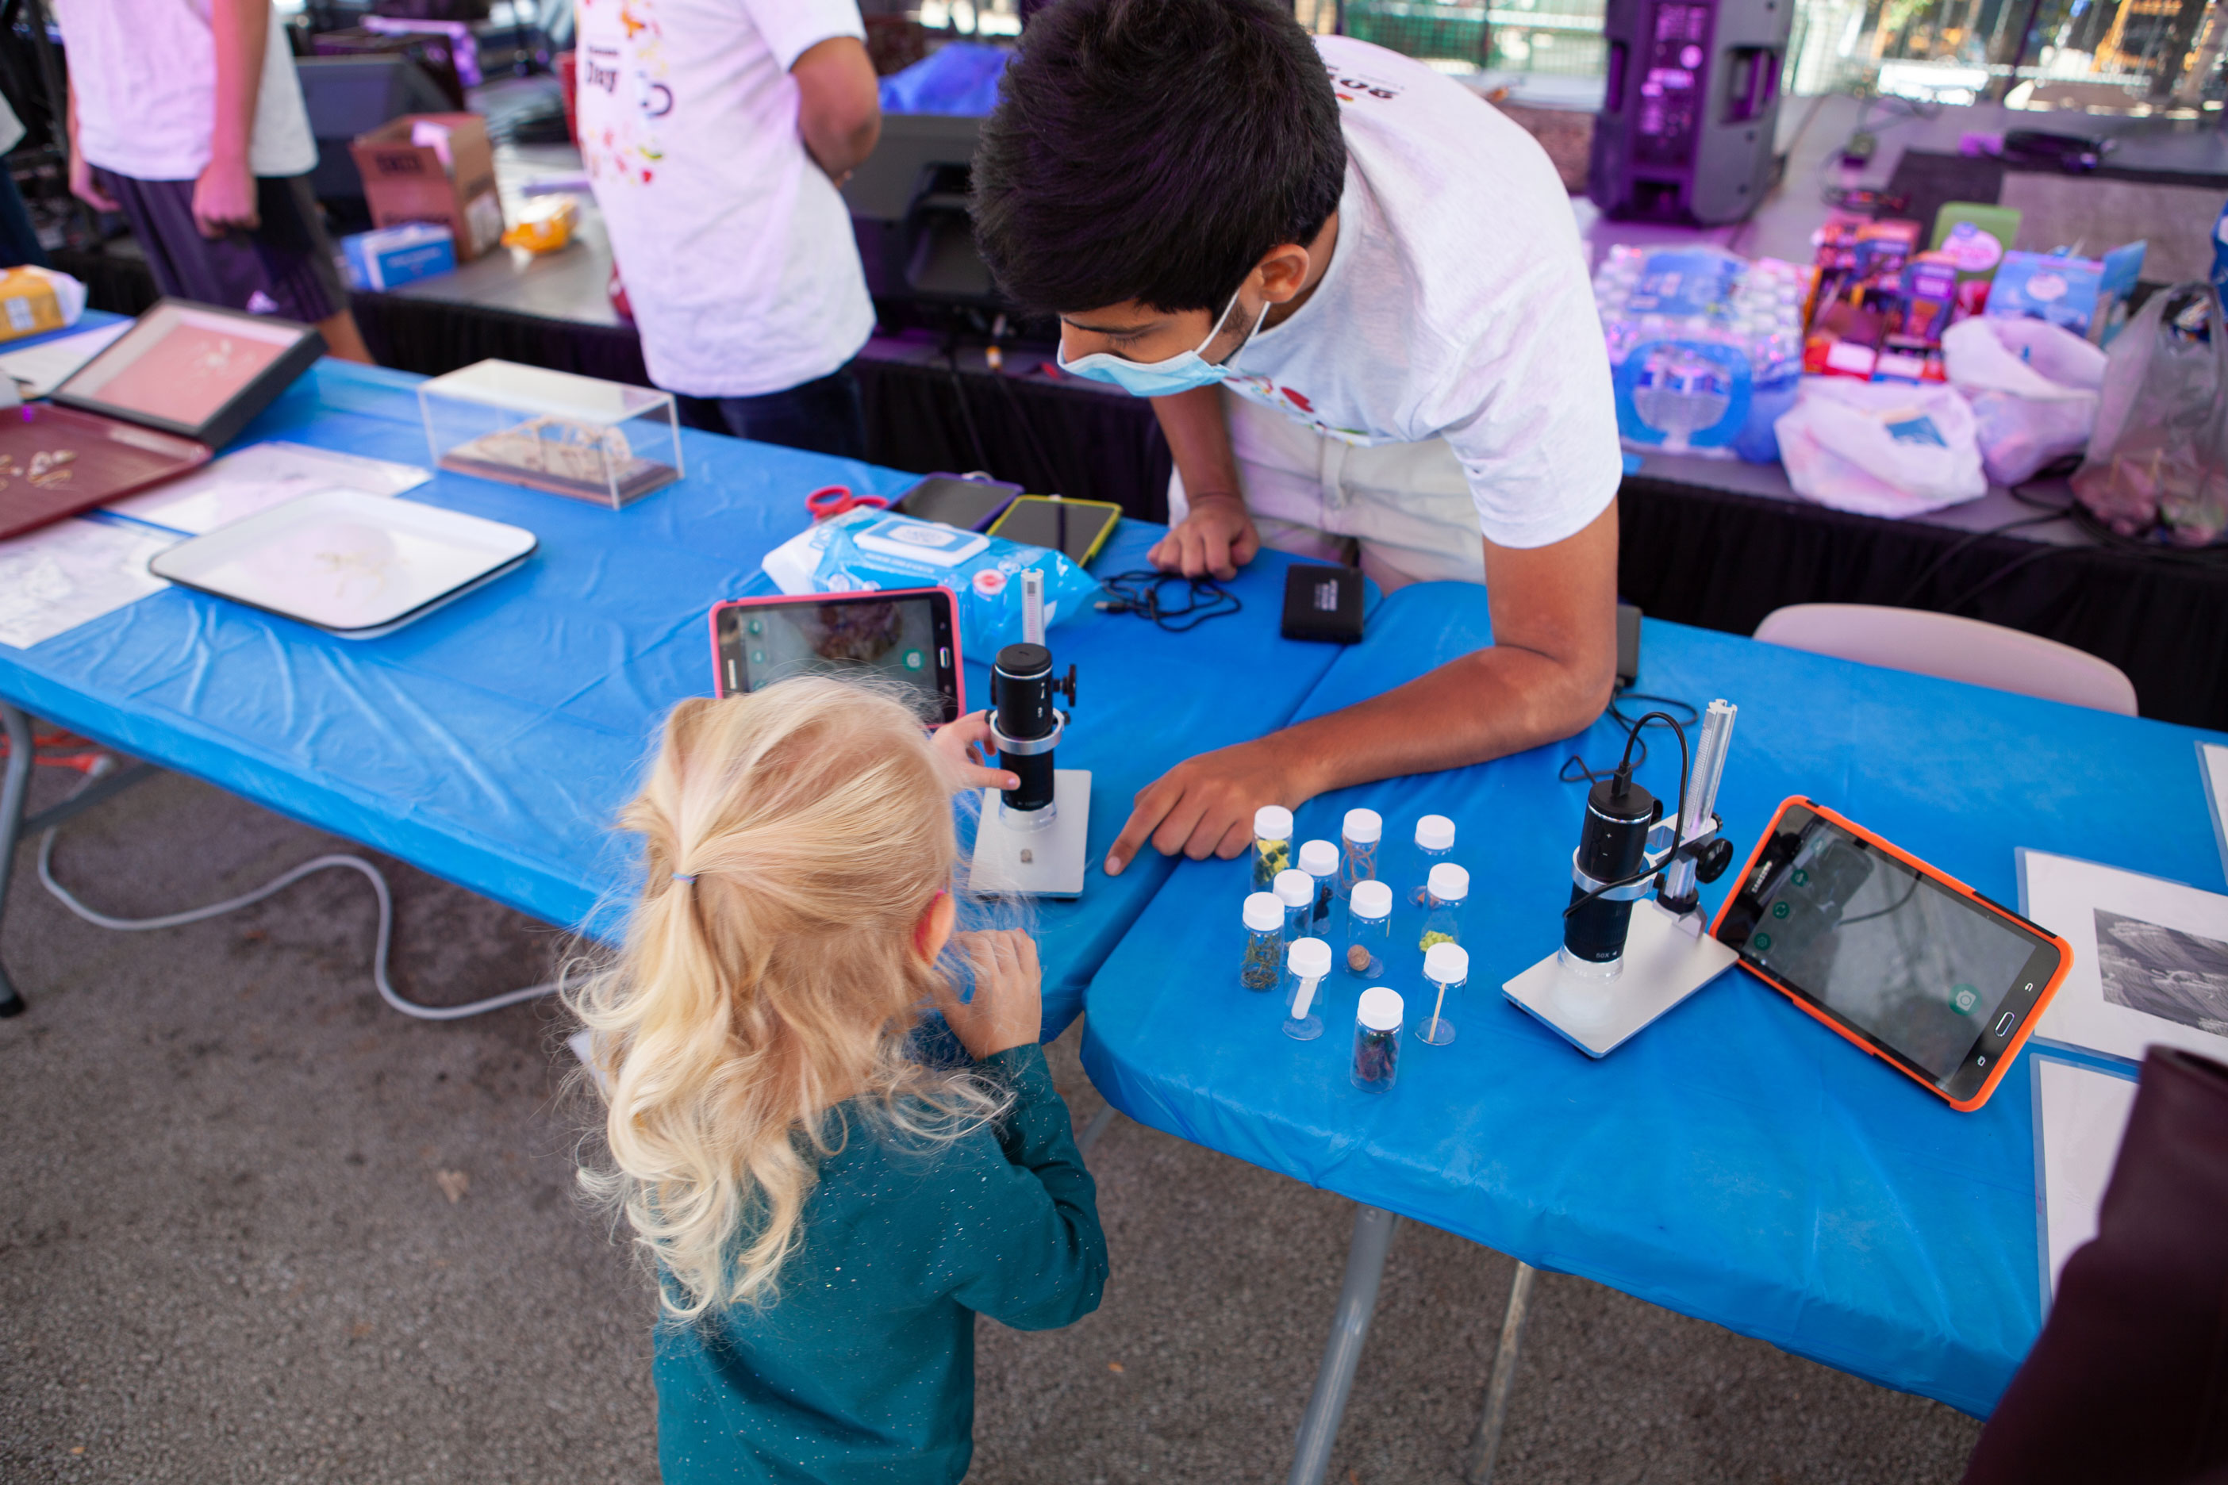
Nationally Recognized Program
Partners include:
Champaign Unit 4 Public Schools
Abbott Laboratories
American Association for the Advancement of Science
Field Museum of Chicago
National Academy of Sciences
National Courts and Sciences Institute
National Institutes of Health
Programs include:
IGB At-Home
Art of Science exhibits
Genome Day
Genomics forTM Judges, Physicians, Teachers, Journalists, Faith Leaders
World of Genomics
Claudia Lutz, Outreach Activities Manager

