Slide 4
2007
INSTITUTE ESTABLISHED
752%
16 YEAR ROI
$639M
TOTAL FUNDING
5Y
REVIEW CYCLE
43
LICENSES OPTIONED
39
PATENTS ISSUED
23
START-UP &
SMALL COMPANIES
203
PATENT APPLICATIONS
155
FACULTY
147
FACULTY
AFFILIATES
91
POSTDOCTORAL
RESEARCHERS
241
GRADUATE
STUDENTS
143
UNDERGRADUATE
STUDENTS
11
VISITING
RESEARCHERS

Slide 5
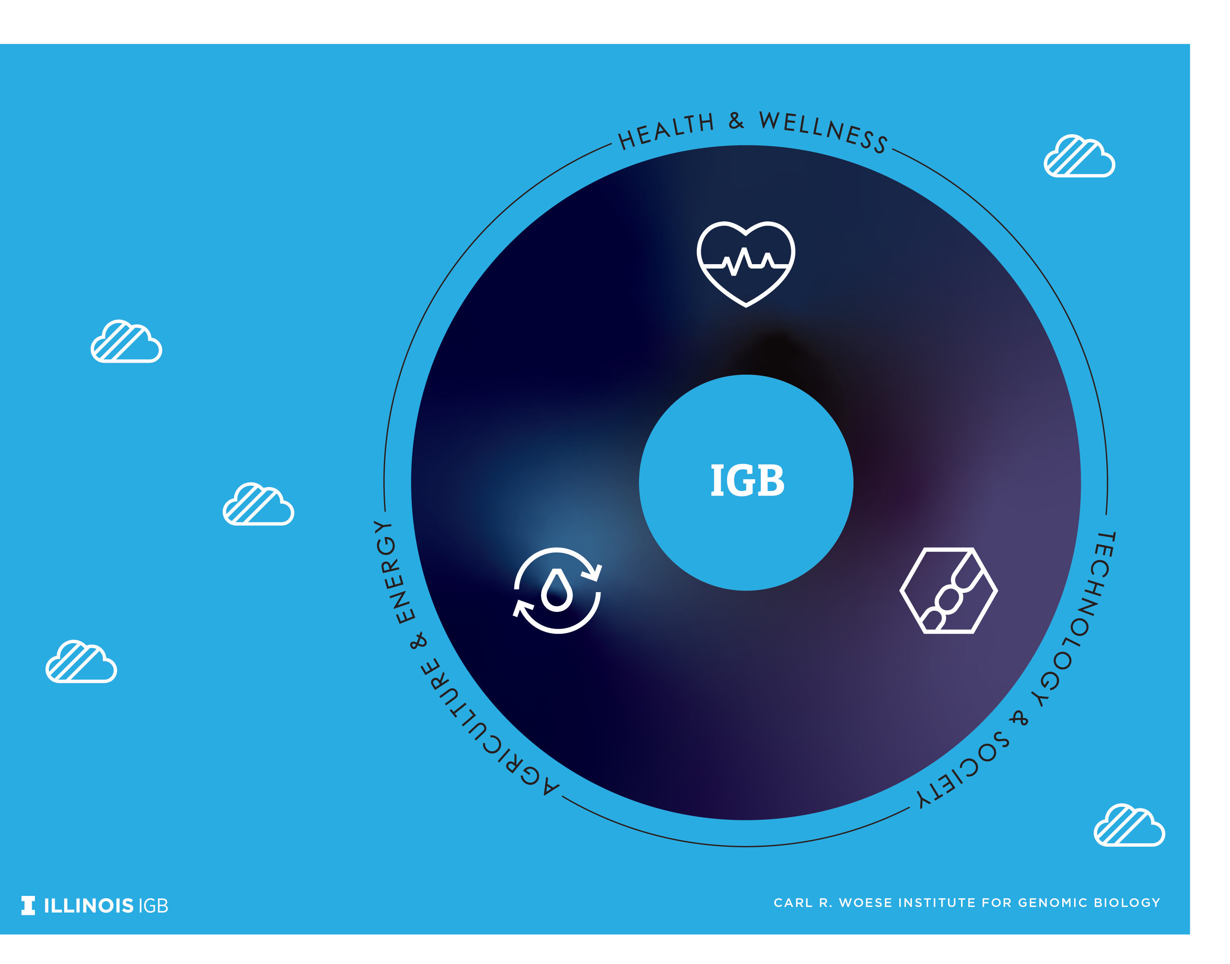
IGB RESEARCH PORTFOLIO
GENOMIC-POWERED SOLUTIONS
TO SOCIETAL CHALLENGES
Personalized
Cancer
Treatments
Predictive
Health
Faster, More
Affordable Diagnostics
Pandemic Responses
Brain &
Behavior
Novel Antibiotics
Pandemic
Preparedness
Custom
Microbiomes
Genomic Security
Food Security
Tissue
Engineering
Biofoundries
Novel
Bioproducts
Complex
Biosystems Modeling
Fundamental Research
Expands the horizons of
human knowledge, revealing new realms of scientific possibility in every arena.
Sustainable Fuels

Slide 6
IGB RESEARCH THEMES
GRAND CHALLENGES IN SCIENCE AND SOCIETY
Anticancer Discovery from Pets to People
Biosystems Design
Center for Advanced Bioenergy and Bioproducts Innovation
Center for Artificial Intelligence
and Modeling
Center for Genomic Diagnostics
Center for Indigenous Science
Environmental Impact on
Reproductive Health
Genomic Ecology of Global Change
Gene Networks in Neural & Developmental Plasticity
Genomic Security and Privacy
Infection Genomics for One Health
Microbiome Metabolic Engineering
Mining Microbial Genomes
Multi-Cellular Engineered
Living Systems
Regenerative Biology &
Tissue Engineering

Slide 7



IGB RESEARCH PORTFOLIO
ONGOING STRATEGIC PARTNERSHIPS AND INITIATVES
Center For Advanced Bioenergy and Bioproducts Innovation
Department of Energy in partnership with 16 universities and national labs
Genomics and Eco-evolution of Multi-scale Symbioses
Interdisciplinary Institute researching pollinator interaction model to understand impact and dynamics of nested microbes.
HPCBio
High Performance Biological Computing
Carver Biotechnology Center
MSI
Microbial Systems Initiative
Campus-wide effort in partnership with 8 departments
Molecule Maker Lab Institute
Interdisciplinary initiative with leaders in AI and organic synthesis with Penn State and Rochester Institute of Technology
Personalized Nutrition Initiative
Partnership between IGB and the College of Agricultural, Consumer and Environmental Sciences (ACES)
PNI
Zeiss Labs@location Partnership
Zeiss Microscopy

Slide 8
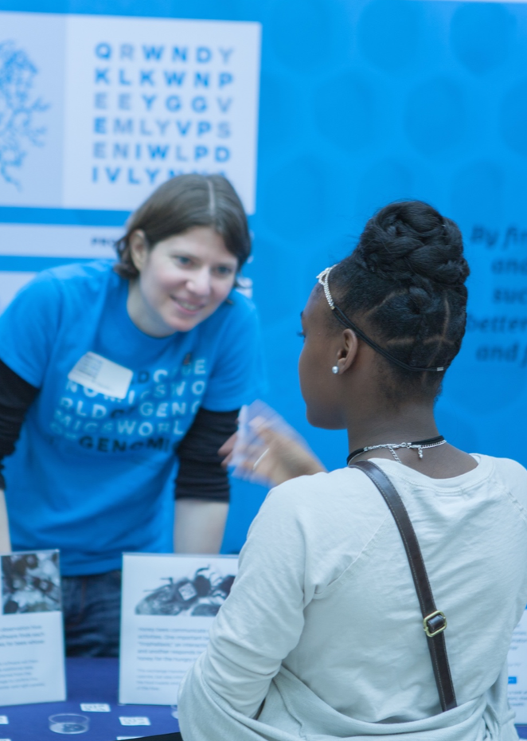
Outreach and
Public Engagement
Fulfill Land Grant mission
Help faculty get big grants
Make new friends—help seed philanthropic efforts
Contribute to trainee professional development

Slide 10
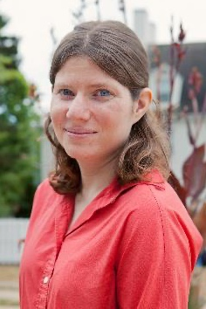
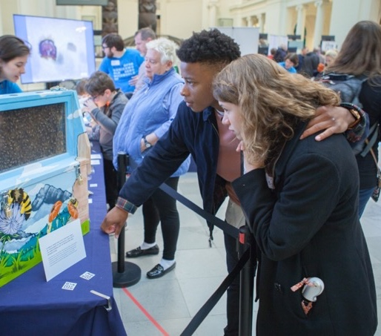
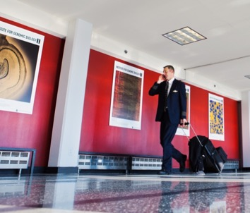
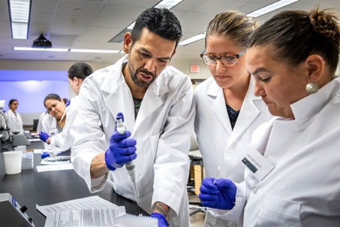
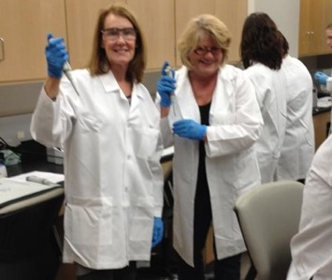

Nationally Recognized Program
Partners include:
Champaign Unit 4 Public Schools
Abbott Laboratories
American Association for the Advancement of Science
Field Museum of Chicago
National Academy of Sciences
National Courts and Sciences Institute
National Institutes of Health
Programs include:
IGB At-Home
Art of Science exhibits
Genome Day
Genomics forTM Judges, Physicians, Teachers, Journalists, Faith Leaders
World of Genomics
C. Lutz
Outreach Activities Manager

