Slide 7
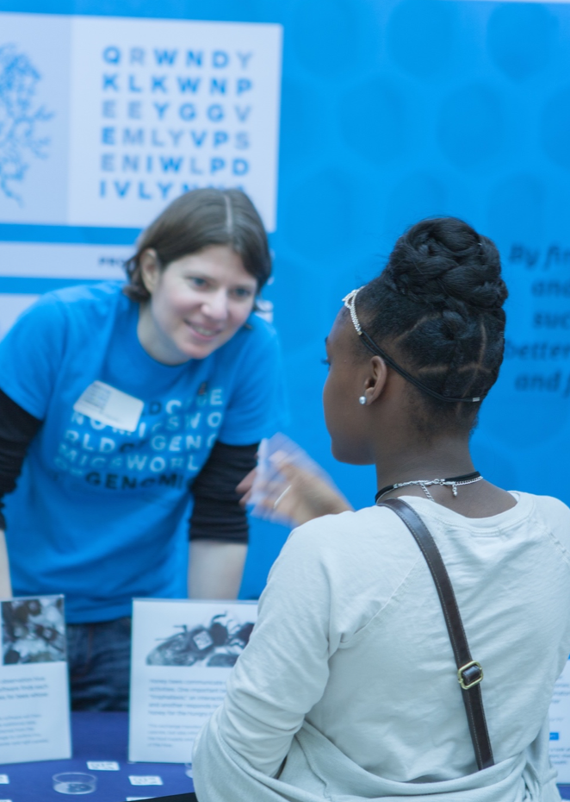
Outreach & Public Engagement
Fulfill Land Grant mission
Seize the moment
Help faculty get big grants
Make new friends

Slide 9
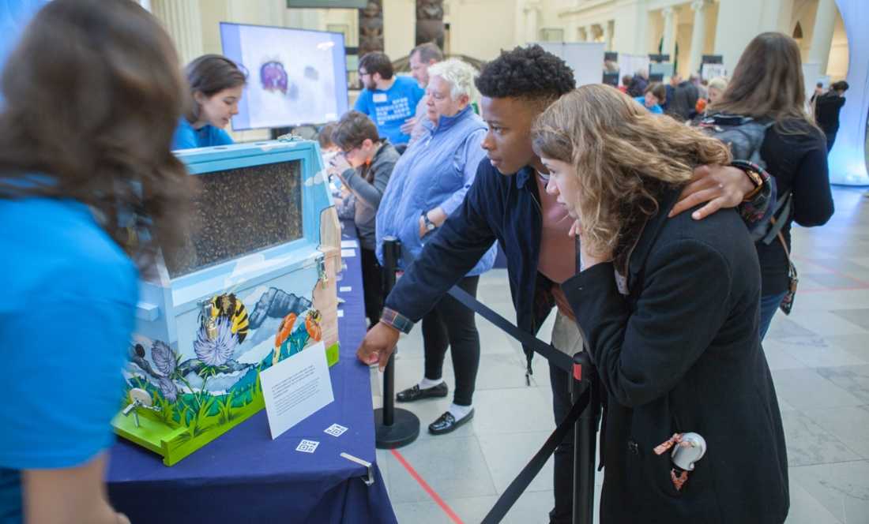
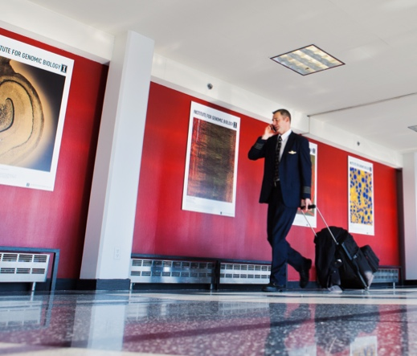

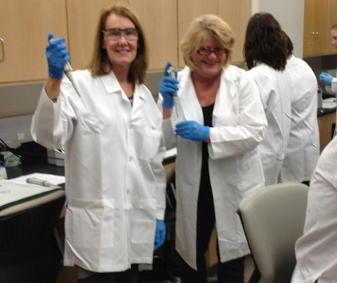
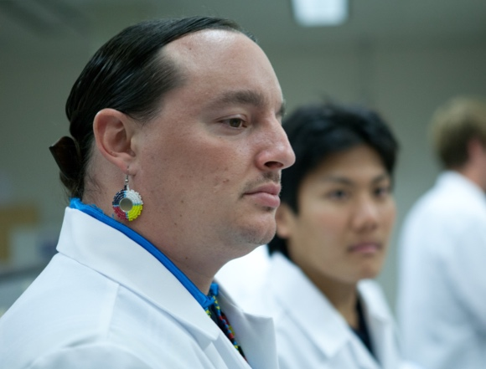
Entrepreneurship,
Education & Public Engagement
Fox Family Entrepreneurship Program
Proof of Concept Awards (with OVCR)
NSF $3.2M IGERT (grad training)
Art of Science exhibits
Diversity in workforce program – partnership with Fisk University
OLLI Citizen Scientists
Genome Day
Pollen Power! Summer Camp
iGEM (undergrad training)
Summer internship for INdigenous peoples in Genomics (SING)
BGI Exchange
Massive Online Open Courses
Genomics forTM Judges
World of Genomics at Field Museum, Chicago

