Slide 1
Promoting Inclusion and Fairness in the Lab
Ross Wantland
Office of the Vice Chancellor for Diversity, Equity & Inclusion

Slide 2
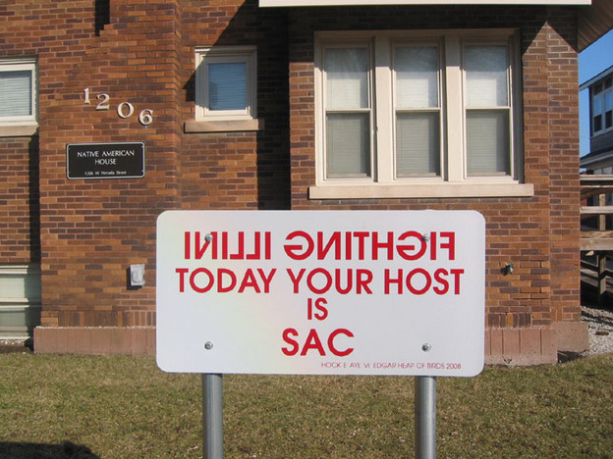
Land Acknowledgment
We are on the lands of the Peoria, Kaskaskia, Piankashaw, Wea, Miami, Mascoutin, Odawa, Sauk, Mesquaki, Kickapoo, Potawatomi, Ojibwe, and Chickasaw Nations.
These lands were the traditional territory of these Native Nations prior to their forced removal; these lands continue to carry the stories of these Nations and their struggles for survival and identity.
Pictured: Beyond the Chief exhibit by Hock E Aye Vi Edgar Heap of Birds

Slide 3
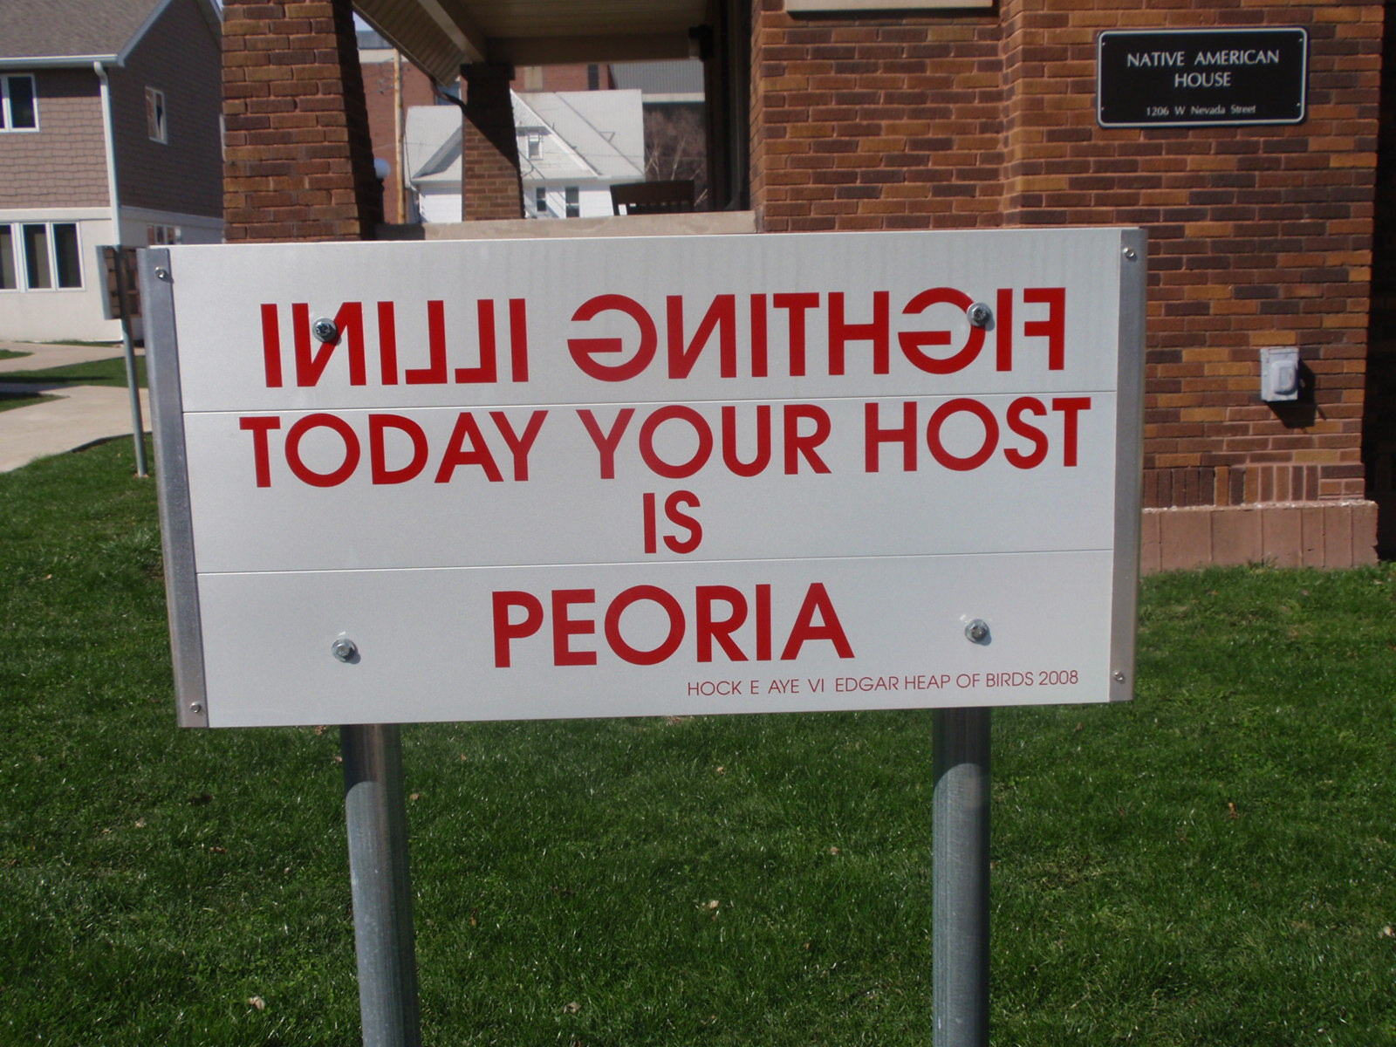
Land Acknowledgment
“[Land] acknowledgement is a way that people insert an awareness of Indigenous presence and land rights in everyday life. It can be a subtle way to recognize the history of colonialism and a need for change in settler colonial societies.” (Native-Land.ca)
Whose land are you on?
Visit native-land.ca to learn more
Pictured: Beyond the Chief exhibit by Hock E Aye Vi Edgar Heap of Birds

Slide 4
Introduction

Slide 5
Today’s Goals
Identify issues with inclusion, access, and equity in labs
Discuss strategies for creating an inclusive and supportive lab
Practice responding to situations to support inclusion

Slide 6
Assumptions and Agreements
Racism, sexism, ableism, classism, antisemitism, and other forms of oppression harm our communities
We all hold biases and stereotypes about groups of people
We have all been impacted by these systems
We can best speak from our own individual experiences
We must come together to resolve these issues

Slide 7
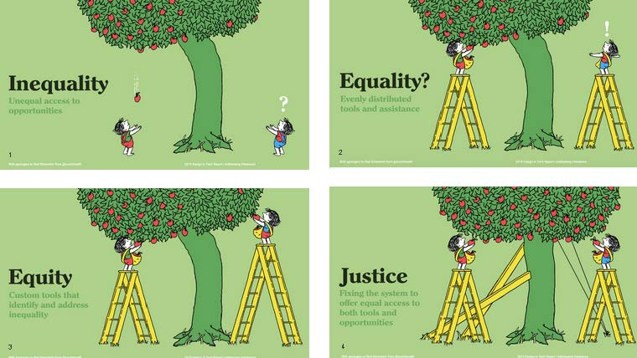

Slide 8
Why is this important?
Equal access to education and fields of study
Representation and visibility
Embracing everyone’s contributions & creativity
Congruence with our values

Slide 9
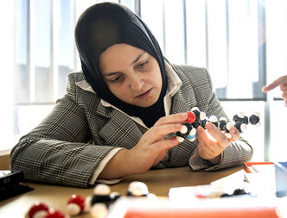
Why is this important?
“I observed patterns in the data that were missed by sighted people who were just looking at the trajectory.”
- Mona Minkara, Assistant Professor, Northeastern University who developed a mechanism to mathematically “see” protein movement

Slide 10
Why is this important?
“Every time you misgender me, you are saying, “This space isn’t created for you. I don’t see you as yourself.” You are stating not only that you don’t see me as me, but also that I don’t deserve to be seen or to exist.”
- Micah Savin, PhD Candidate in Neuropsychology, Fordham University

Slide 11
Goals for Lab Members
What are some of the goals for researchers in a lab? What are markers of their success?
Use the Jamboard link in the chat to add your responses.

Slide 12
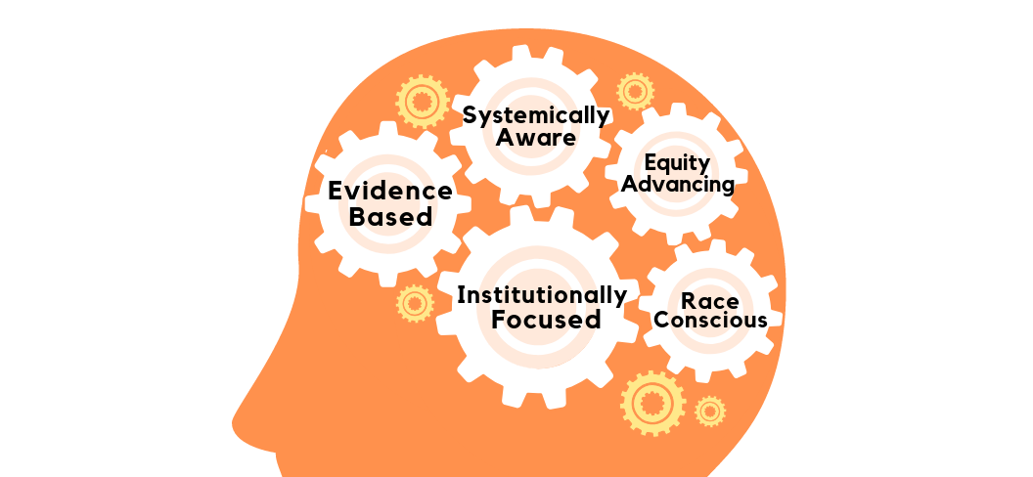
Equity-Mindedness
USC Center for Urban Education

Slide 13
Identifying Inequity
This model suggests that we must:
Personally and collectively address equity
Be conscious of race and other social groups (gender, sexuality, ability, class, religion, etc.)
Pay attention to the entire system that precedes, follows and includes the lab experience
Attend to the practices, policies, behaviors in our institution
Gather data to better understand the issues

Slide 14
Barriers to Equity
Using the same Jamboard, what are some of the barriers to equity in University departments and labs?
What is the impact of these barriers?

Slide 15
History
Support
Access
Knowledge
Pipelines
Representation in society and curriculum
Historic factors that have impacted opportunity & access
Degree of mentorship, safety, and support available
Opportunities to succeed and fail
Equal access to opportunities for advancement
Intercultural knowledge, attitudes, and skills to work together
Understanding how to promote inclusion in lab, class, dept
Addressing the barriers and gatekeepers to participation
Building and strengthening pipelines to increase involvement
Practices for creating supportive research communities

Slide 16
Does Intent Matter?
The impact of unintentional racism—the ways we participate in and bolster racism without actively trying to do so—is indistinguishable from the impact of intentional racism. Imagining myself as a good person, as a progressive person, means little if I am not examining and changing the impact I’m having even through actions I once took without intention.
- Paul Gorski, EdChange.org

Slide 17
What Can We Do?

Slide 18
Promoting Inclusion & Equity
Develop our personal awareness and tools to recognize bias and inequity
Build individual and collective strategies to respond to discreet moments of bias
Create local and institutional practices to build capacity, create more fair-minded spaces

Slide 19
Addressing Our Stereotypes
Stereotype replacement
Counter-stereotypic imagery
Individuation
Perspective Taking
Increasing opportunities for contact
(Devine, et al., 2012)
Notes:
(slide notes: Stereotype replacement
This strategy involves replacing stereotypical responses for non-stereotypical responses. Using this strategy to address personal stereotyping involves recognizing that a response is based on stereotypes, labeling the response as stereotypical, and reflecting on why the response occurred. Next one considers how the biased response could be avoided in the future and replaces it with an unbiased response (Monteith, 1993). A parallel process can be applied to societal (e.g., media) stereotyping.
Counter-stereotypic imaging
This strategy involves imagining in detail counter-stereotypic others (Blair et al., 2001). These others can be abstract (e.g., smart Black people), famous (e.g., Barack Obama), or non-famous (e.g., a personal friend). The strategy makes positive exemplars salient and accessible when challenging a stereotype’s validity.
Individuation
This strategy relies on preventing stereotypic inferences by obtaining specific information about group members (Brewer, 1988; Fiske & Neuberg, 1990). Using this strategy helps people evaluate members of the target group based on personal, rather than group-based, attributes.
Perspective taking
This strategy involves taking the perspective in the first person of a member of a stereotyped group. Perspective taking increases psychological closeness to the stigmatized group, which ameliorates automatic group-based evaluations (Galinsky & Moskowitz, 2000).
Increasing opportunities for contact
This strategy involves seeking opportunities to encounter and engage in positive interactions with out-group members. Increased contact can ameliorate implicit bias through a wide variety of mechanisms, including altering the cognitive representations of the group or by directly improving evaluations of the group (Pettigrew, 1998; Pettigrew & Tropp, 2006).
Devine, et al., 2012 “Long-term reduction in implicit race bias: A prejudice habit-breaking intervention.” https://www.ncbi.nlm.nih.gov/pmc/articles/PMC3603687/)

Slide 20
Educating Ourselves
Read and listen to underrepresented voices from your field
Attend educational opportunities to learn ways to apply this as researchers, advisors, instructors, and community members
Engage in dialogue with one another
Notes:
(slide notes: Stereotype replacement
This strategy involves replacing stereotypical responses for non-stereotypical responses. Using this strategy to address personal stereotyping involves recognizing that a response is based on stereotypes, labeling the response as stereotypical, and reflecting on why the response occurred. Next one considers how the biased response could be avoided in the future and replaces it with an unbiased response (Monteith, 1993). A parallel process can be applied to societal (e.g., media) stereotyping.
Counter-stereotypic imaging
This strategy involves imagining in detail counter-stereotypic others (Blair et al., 2001). These others can be abstract (e.g., smart Black people), famous (e.g., Barack Obama), or non-famous (e.g., a personal friend). The strategy makes positive exemplars salient and accessible when challenging a stereotype’s validity.
Individuation
This strategy relies on preventing stereotypic inferences by obtaining specific information about group members (Brewer, 1988; Fiske & Neuberg, 1990). Using this strategy helps people evaluate members of the target group based on personal, rather than group-based, attributes.
Perspective taking
This strategy involves taking the perspective in the first person of a member of a stereotyped group. Perspective taking increases psychological closeness to the stigmatized group, which ameliorates automatic group-based evaluations (Galinsky & Moskowitz, 2000).
Increasing opportunities for contact
This strategy involves seeking opportunities to encounter and engage in positive interactions with out-group members. Increased contact can ameliorate implicit bias through a wide variety of mechanisms, including altering the cognitive representations of the group or by directly improving evaluations of the group (Pettigrew, 1998; Pettigrew & Tropp, 2006).
Devine, et al., 2012 “Long-term reduction in implicit race bias: A prejudice habit-breaking intervention.” https://www.ncbi.nlm.nih.gov/pmc/articles/PMC3603687/)

Slide 21
Understanding Our Implicit Assumptions
Example screen from Harvard’s Implicit Assumption Test (implicit.harvard.edu)

Slide 22
Intervention Strategies
Have the conversation
Focus on impact of bias/behavior, rather than individual’s character
Engage with humility
Utilize the group norms, values, purpose to frame conversation
Acknowledge then move on
Learn about & offer resources

Slide 23
Focus on the Behavior
When somebody picks my pocket, I’m not going to be chasing them down so I can figure out whether he feels like he’s a thief deep down in his heart. I’m going to be chasing him down so I can get my wallet back. I don’t care what he is, but I need to hold him accountable for what he did.
That’s how we need to approach these conversations about race. Treat them like they took your wallet and focus on the part that matters, holding each person accountable for the impact of their words and actions.
- Jay Smooth
This Photo by Unknown Author is licensed under CC BY-SA-NC
Notes:
Ross

Slide 24
Responding to Bias in Organizations
Find support (mentor, buddy, ally)
Address the concern as you are able
Strategize together how to address this bias in the long term
Keep an eye out for tokenization, exploitation
Advocate, work for change utilizing your power base

Slide 25
Tips for Building an Antiracist Lab
Lead informed discussions about antiracism in your lab regularly
Address racism in your lab and field safety guidelines
Publish papers and write grants with BIPOC colleagues
Evaluate your lab’s mentoring practices
Amplify voices of BIPOC scientists in your field
Support BIPOC in their efforts to organize
Intentionally recruit BIPOC students and staff
Adopt a dynamic research agenda
Advocate for racially diverse leadership in science
Hold the powerful accountable and don’t expect gratitude
- Chaudhary & Berhe, 2020

Slide 26
Changing Our Culture
“It is a lot easier to put a ramp in front of a building than to get people to change the culture of a workplace. Yet it is the culture, not the [unbuilt] ramp, that will drive people away.”
- Jesse Shanahan, astronomer and data scientist

Slide 27
Practicing Response

Slide 28
Scenarios
Divide into groups
Scenario 1 – Groups 1 & 5
Scenario 2 – Groups 2 & 6
Scenario 3 – Groups 3 & 7
Scenario 4 – Groups 4 & 8
Identify:
What is the issue/impact of this incident?
What could you do?
Reflect: In the Jamboard, what are some strategies that came up that are critical for promoting equity?

Slide 29
Types of Bystander Responses
Direct – Speak directly to the individual impacted about the issue
Distract – Distract the participants to temporarily disrupt the situation
Delegate – Find another person who can intervene
Delay – Address the situation at a later time

Slide 30
Scenario One
You notice that one of your lab managers frequently mispronounces the name of a labmate. In lab meetings, the manager appears flustered and asks your labmate, “Is there a more normal name I can call you?” What would you do?

Slide 31
Scenario Two
In team meetings, one of your lab’s external partners continues to address one of the White graduate students with questions about the project, rather than the Black faculty PI who is also in the meeting. Everyone on your team feels awkward in these interactions, but no one seems sure what to do.

Slide 32
Scenario Three
You overhear one of your teammates making disparaging remarks about a colleague with a disability. They say, “I don’t want them on my team – I’ll have to do all the work!” Although you are not part of the conversation, you are concerned about leaving this comment unchecked.

Slide 33
Scenario Four
You and a colleague share your concerns that BIPOC faculty are often asked to serve as informal mentors for BIPOC undergraduate and graduate researchers, which may unduly burden these faculty. You wonder if the department could create mechanisms to respond to this need and inequity. What would you do?

Slide 34
Responding to Bias
Stay in the moment
Decide how to respond, when
Focus on the specific behavior
Share your concern about the impact
Request how you would like this to change, what you need in the future
Reflect on the experience
Notes:
Ross

Slide 35
Creating Antiracist Labs
“Building a lab that is antiracist is very different from building a lab that simply avoids racism. Avoiding racism or stating that one’s lab is “not racist” adopts a neutral stance in a struggle that inherently has no neutrality”
- V. Bala Chaudhary & Asmeret Asefaw Berhe (2020)

Slide 36
Creating Fair-Minded Structures
Listen to and learn about the experiences of marginalized individuals and groups
Accept responsibility and take personal action to promote fairness
Work collectively to improve, change structures to increase access, retention, support, and success.
Notes:
Ross

Slide 37
Questions?

Slide 38
Get Involved
Inclusive Lab Leaders
https://21centurysci.beckman.illinois.edu/inclusive-lab-leaders/
Dr. Kate Clancy kclancy@illinois.edu
IGB Committee on Diversity
Dr. Ripan Malhi mahli@illinois.edu
IGB Committee on Diversity Task Force
Dr. Alisa King-Klemperer amking4@illinois.edu

Slide 39
Articles on Inclusive Labs
Inclusivity for all: How to make your research group accessible (Science, Jan 2020)
How LGBT+ scientists would like to be included and welcomed in STEM workplaces (Nature, Oct 2020)
Ten Simple Rules for Building an Antiracist Lab (PLoS Computational Biology, Oct 2020)

Slide 40
Office of the Vice Chancellor for Diversity, Equity & Inclusion
(217) 300-9580
http://diversity.illinois.edu
diversity@illinois.edu
Office of Access & Equity
ADA Division
Affirmative Action Division
Equal Employment Opportunity Division
Business, Community & Economic Development
Office of Academic Inclusive Excellence
Title IX Office

Slide 41
Contact Us
Office of Academic Inclusive Excellence
Education ● Equity Support ● Organizational Development
Ross Wantland
Director of Curriculum Development and Education
wantland@illinois.edu

Slide 42
Campus Resources: Support
Counseling Center – 333-3704 counselingcenter.Illinois.edu
McKinley Health Center Mental Health – 333-2700 mhc.Illinois.edu
Women’s Resources Center – 333-3137 oiir.Illinois.edu/womens-center
Faculty Staff Assistance Program – 244-5312 humanresources.illinois.edu
Notes:
Ross

Slide 43
Campus Resources: Reporting
Reporting Acts of Bias bart.Illinois.edu
Office of Access and Equity diversity.illinois.edu
Title IX Reporting wecare.Illinois.edu
Office of Student Conflict Resolution 333-3680 conflictresolution.Illinois.edu
Notes:
Ross

